Slide 1
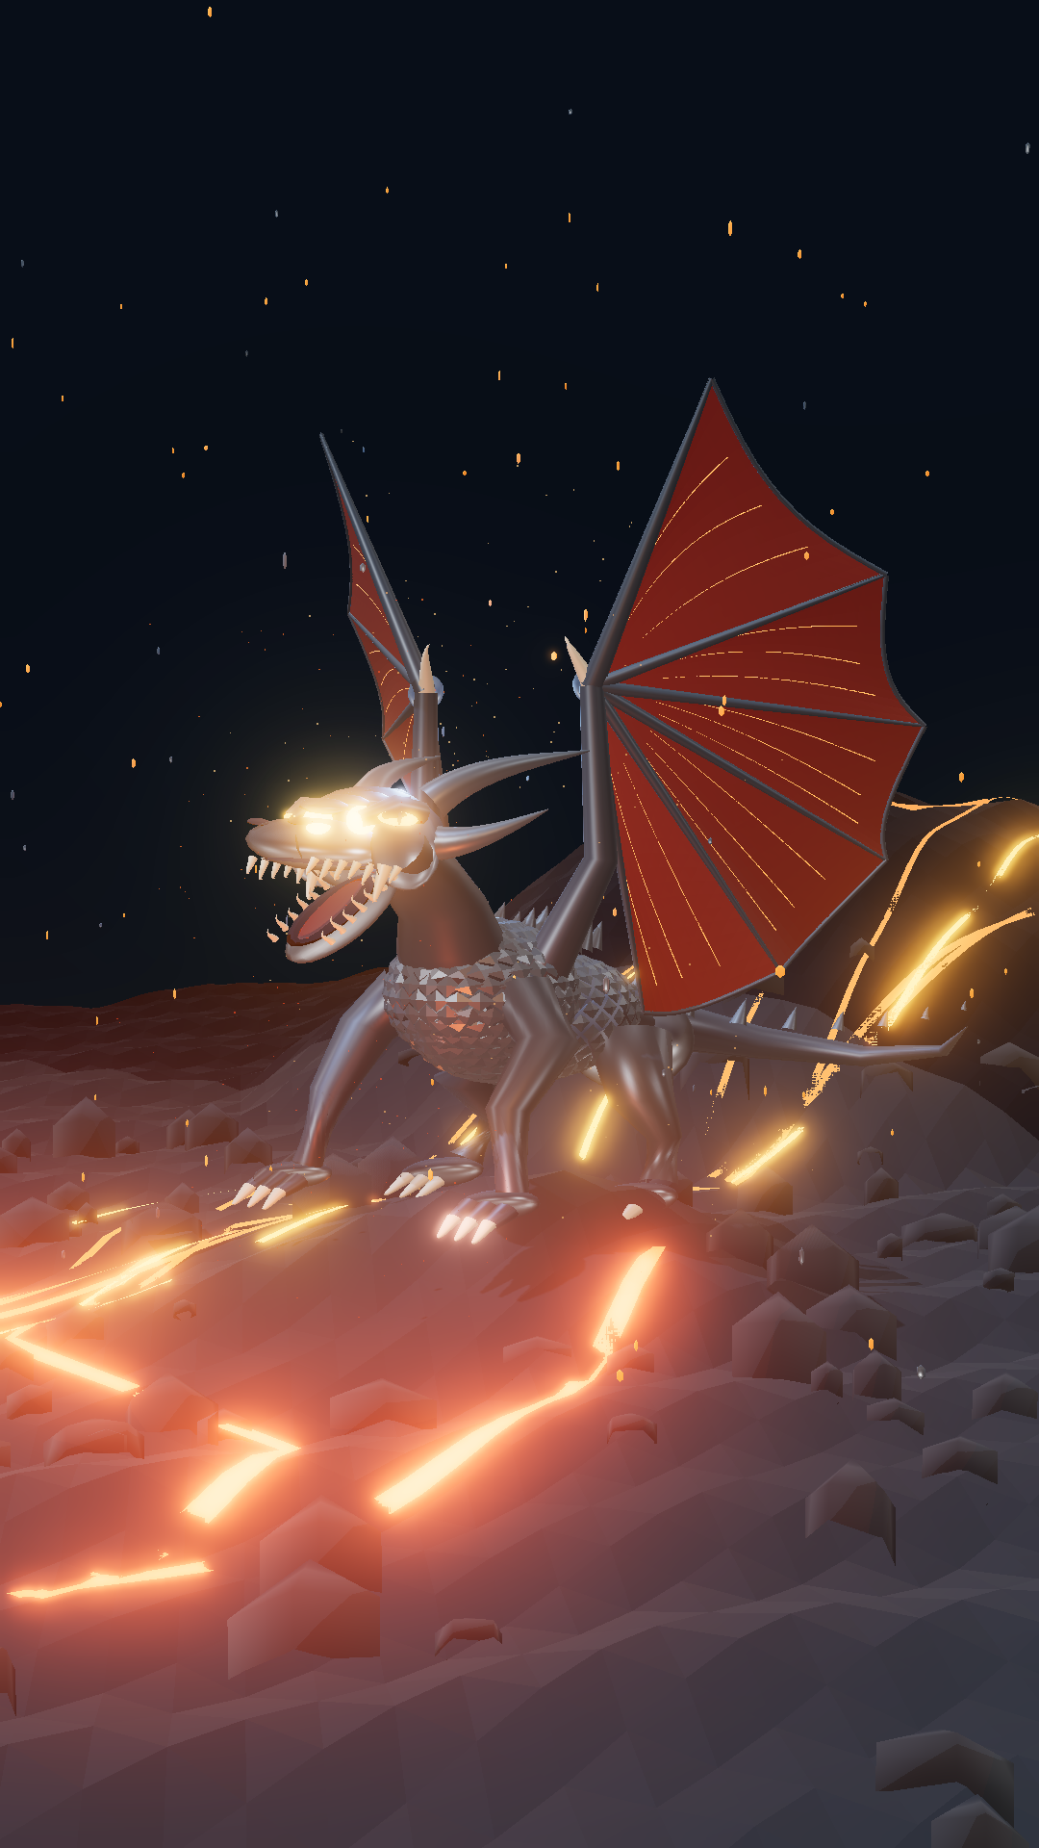
Notes:
Design Studio AI: Hero • 9:16. Structured components rendered as an image.

Slide 2
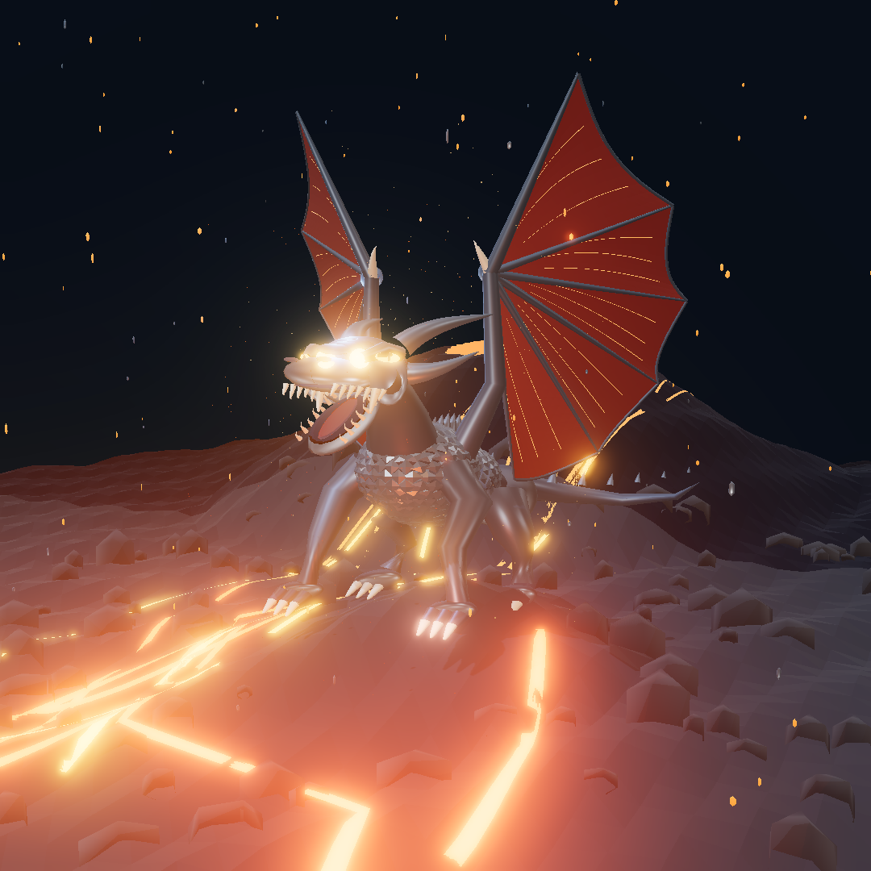
Notes:
Design Studio AI: Hero • 1:1. Structured components rendered as an image.

Slide 3
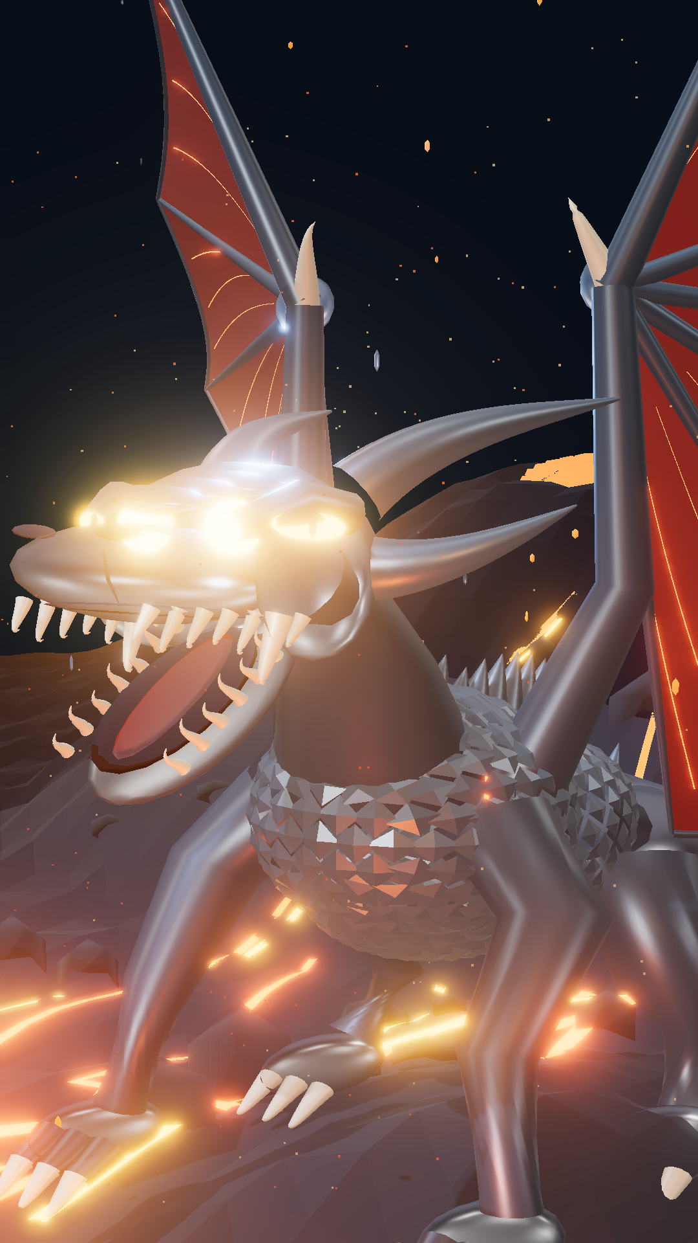
Notes:
Design Studio AI: Roar close-up • 9:16. Structured components rendered as an image.

Slide 4
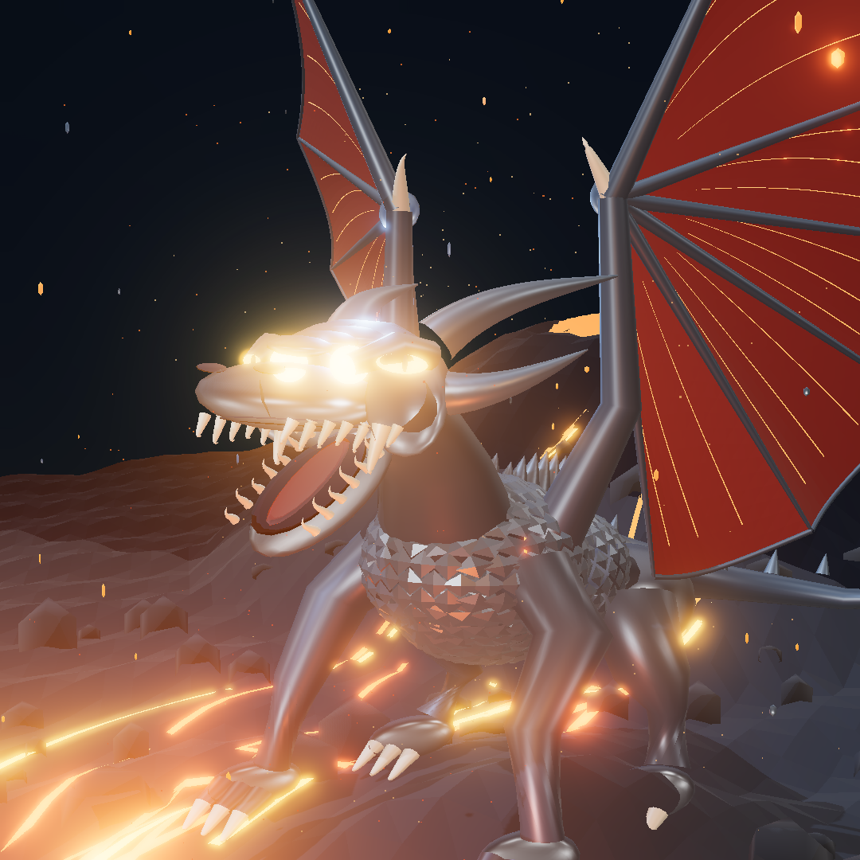
Notes:
Design Studio AI: Roar close-up • 1:1. Structured components rendered as an image.

Slide 5
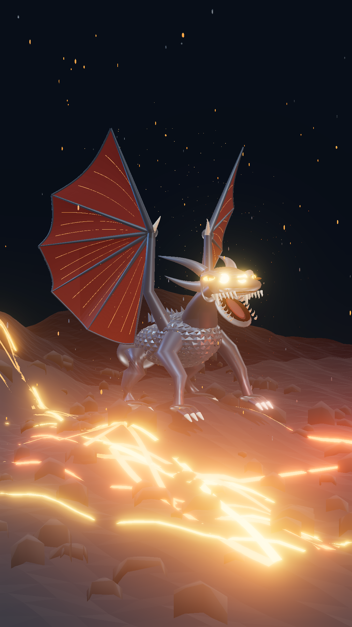
Notes:
Design Studio AI: Wings low-angle • 9:16. Structured components rendered as an image.

Slide 6
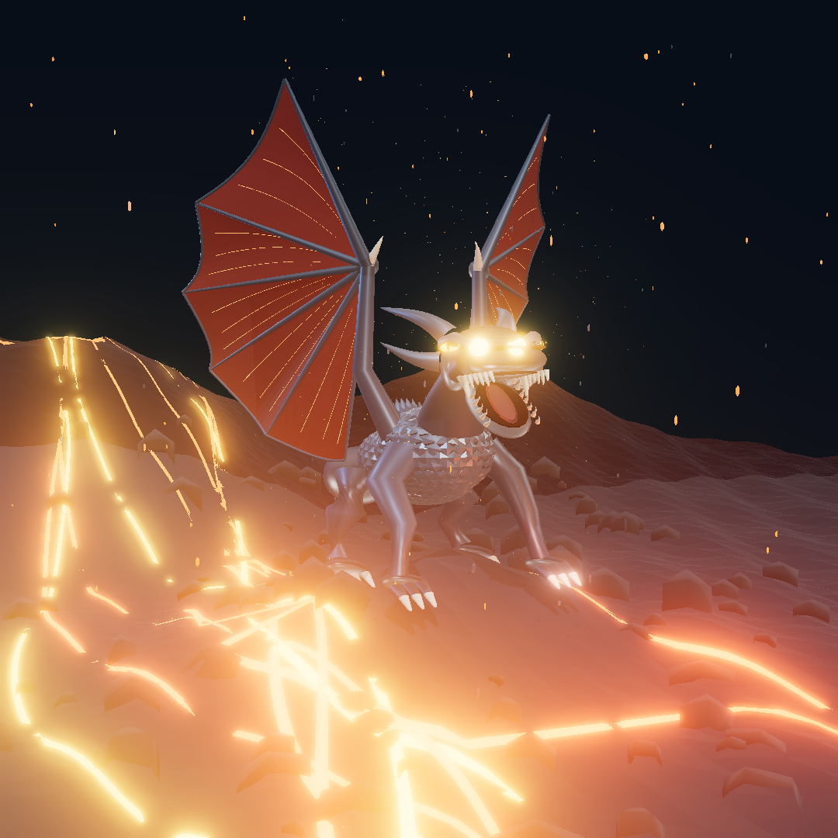
Notes:
Design Studio AI: Wings low-angle • 1:1. Structured components rendered as an image.

