Slide 1
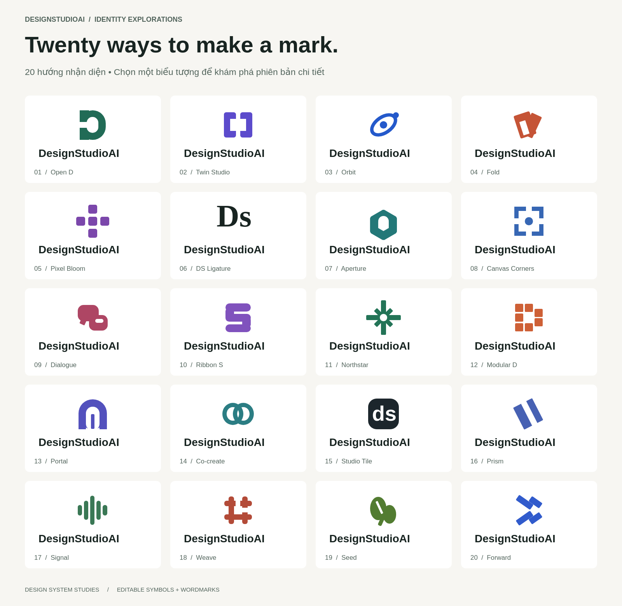
Notes:
Design Studio AI: 00 — All 20 concepts. Structured components rendered as an image.

Slide 2
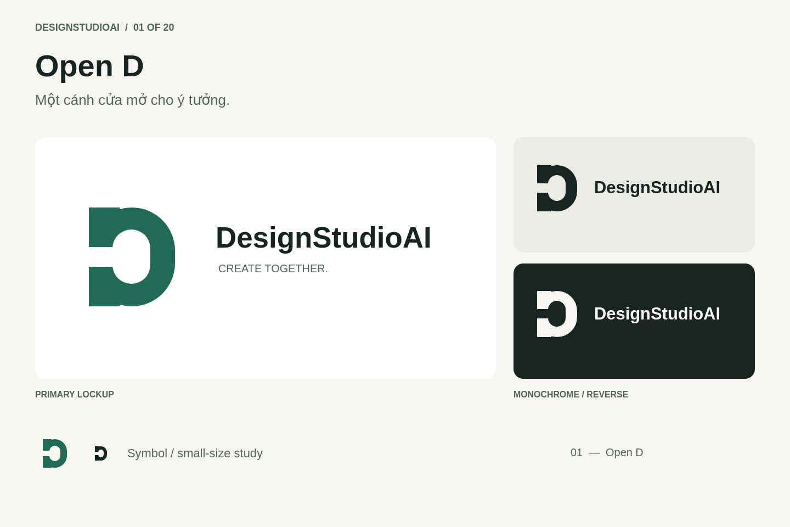
Notes:
Design Studio AI: 01 — Open D. Structured components rendered as an image.

Slide 3
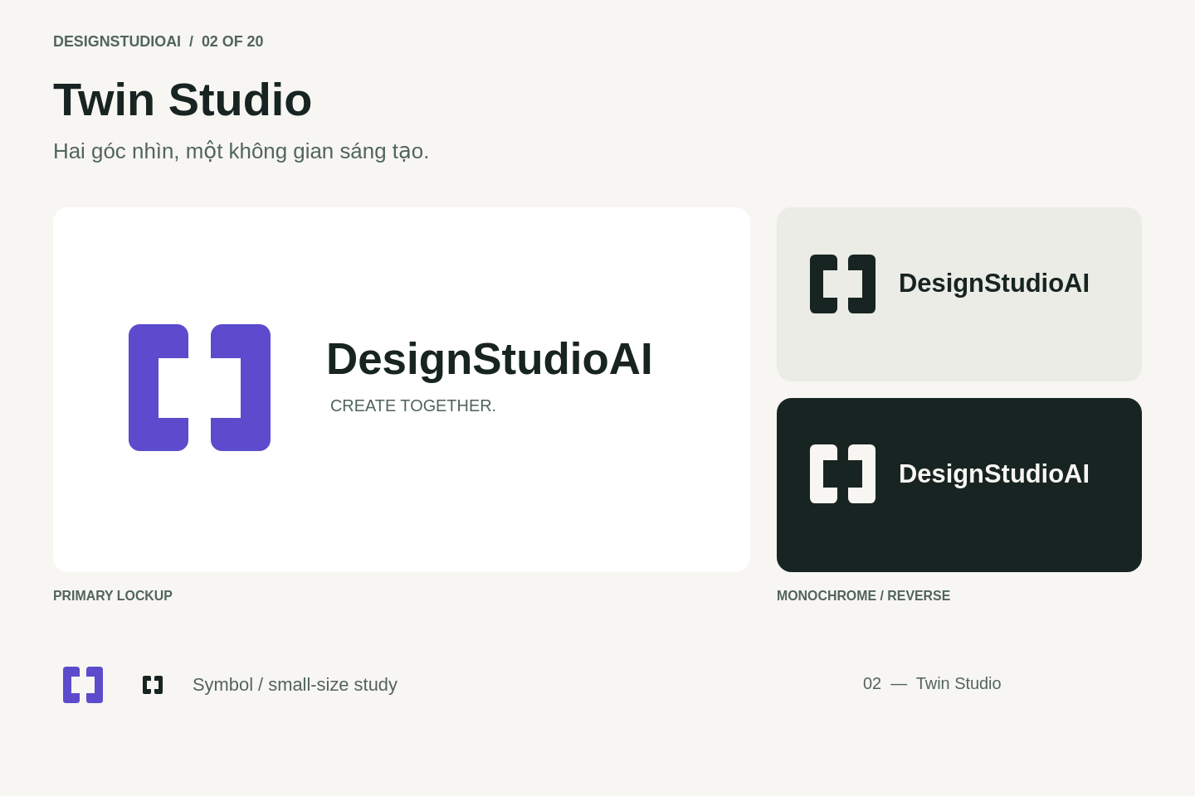
Notes:
Design Studio AI: 02 — Twin Studio. Structured components rendered as an image.

Slide 4
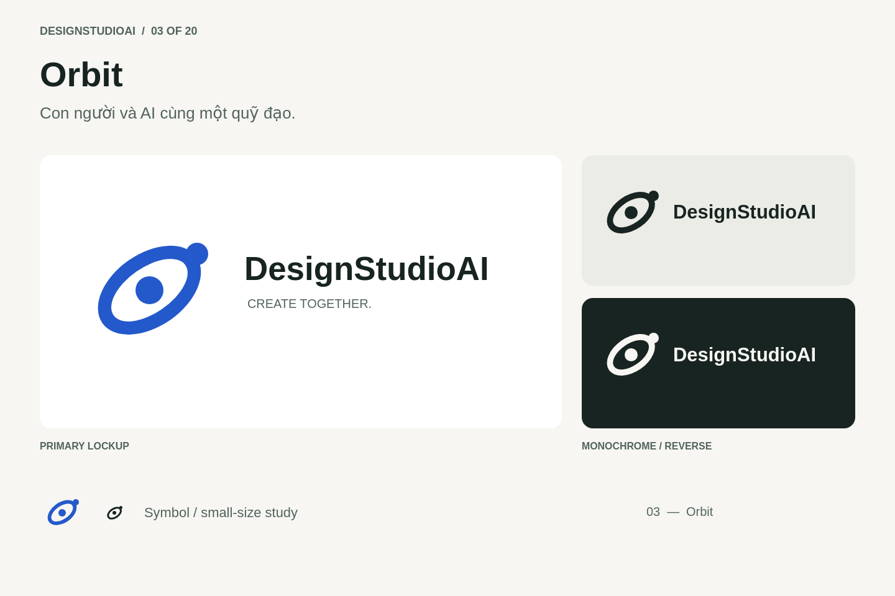
Notes:
Design Studio AI: 03 — Orbit. Structured components rendered as an image.

Slide 5
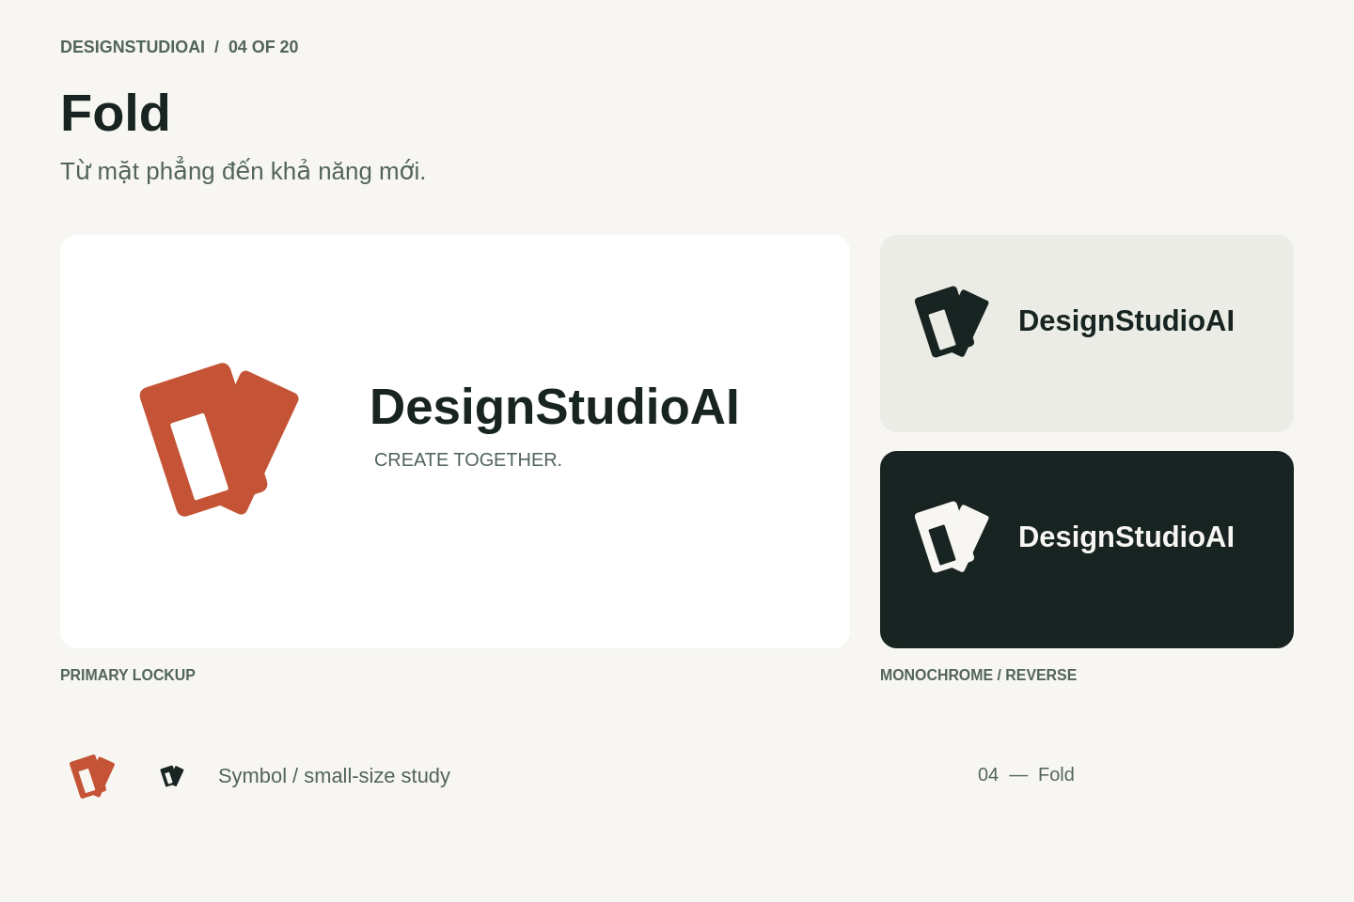
Notes:
Design Studio AI: 04 — Fold. Structured components rendered as an image.

Slide 6
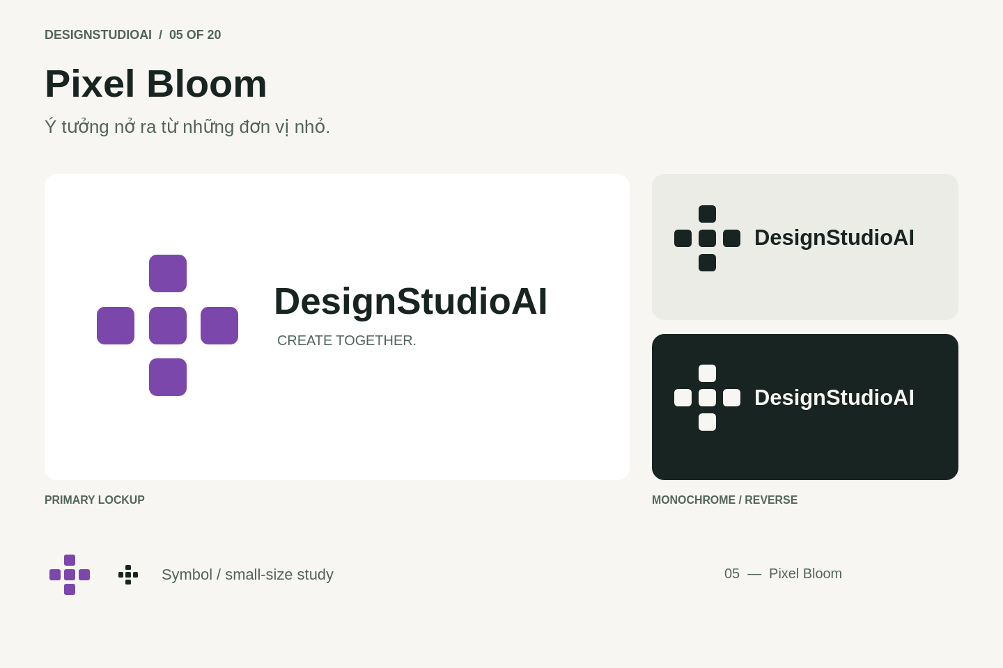
Notes:
Design Studio AI: 05 — Pixel Bloom. Structured components rendered as an image.

Slide 7
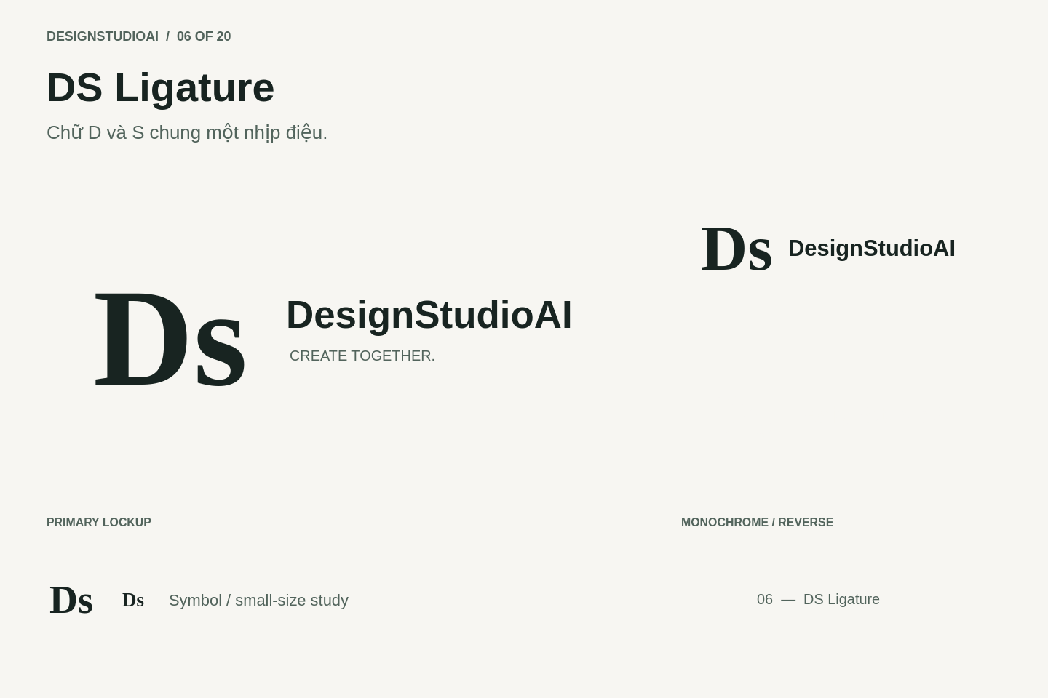
Notes:
Design Studio AI: 06 — DS Ligature. Structured components rendered as an image.

Slide 8

Notes:
Design Studio AI: 07 — Aperture. Structured components rendered as an image.

Slide 9
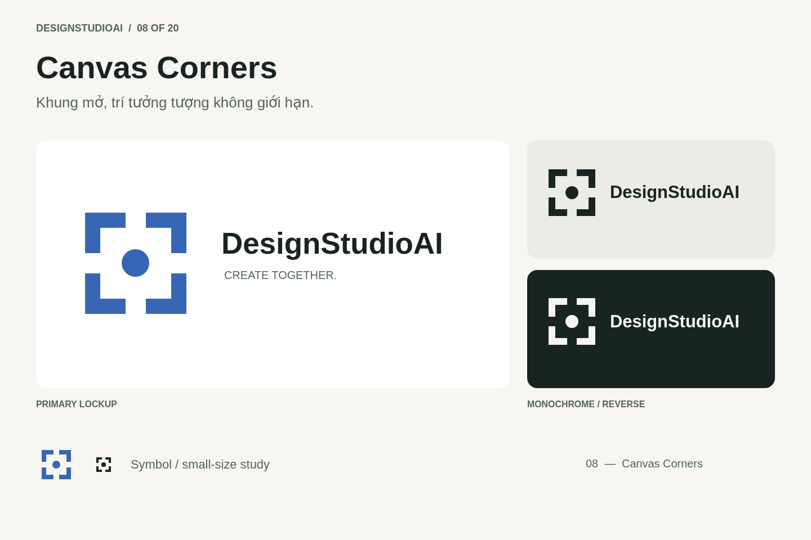
Notes:
Design Studio AI: 08 — Canvas Corners. Structured components rendered as an image.

Slide 10
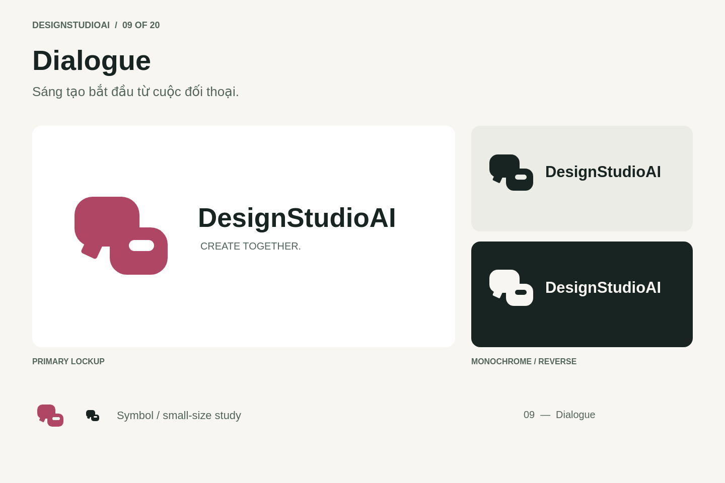
Notes:
Design Studio AI: 09 — Dialogue. Structured components rendered as an image.

Slide 11
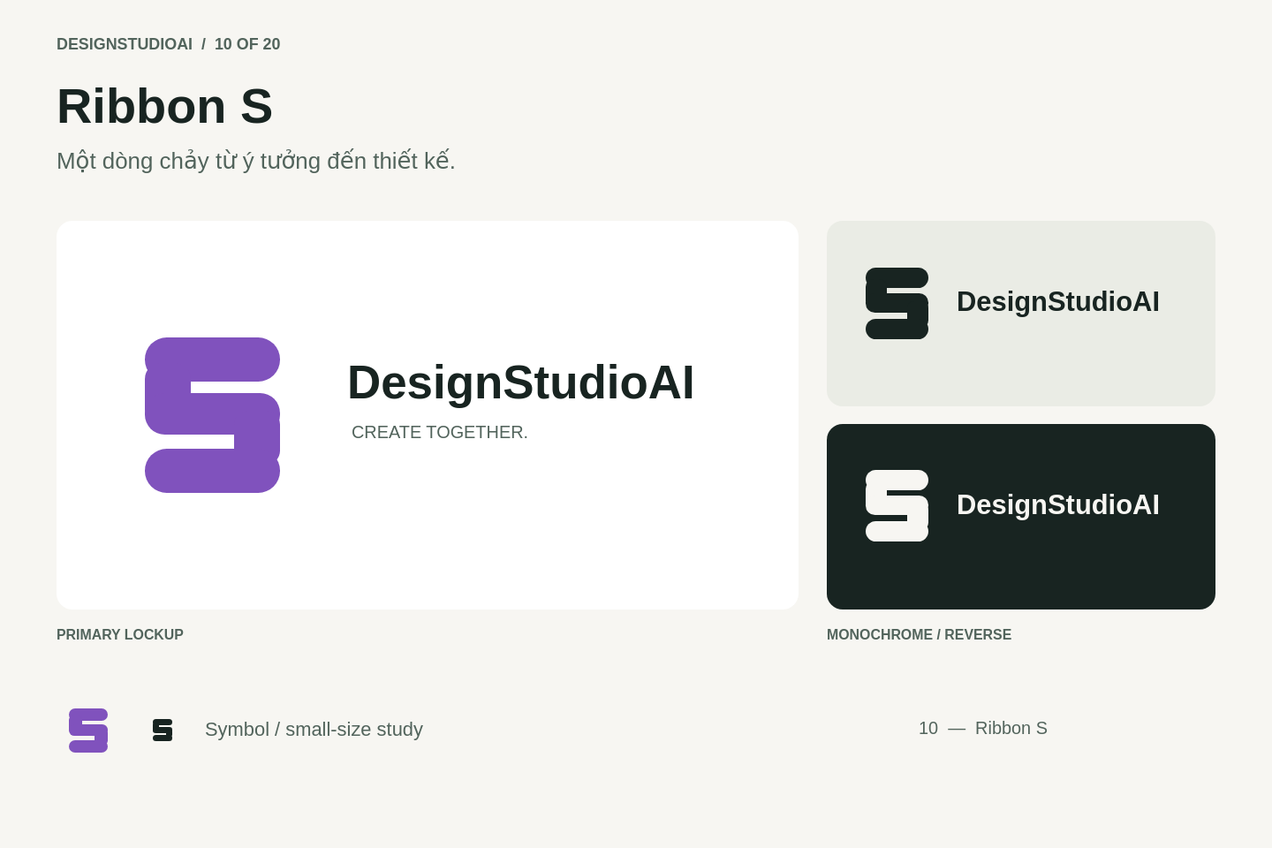
Notes:
Design Studio AI: 10 — Ribbon S. Structured components rendered as an image.

Slide 12
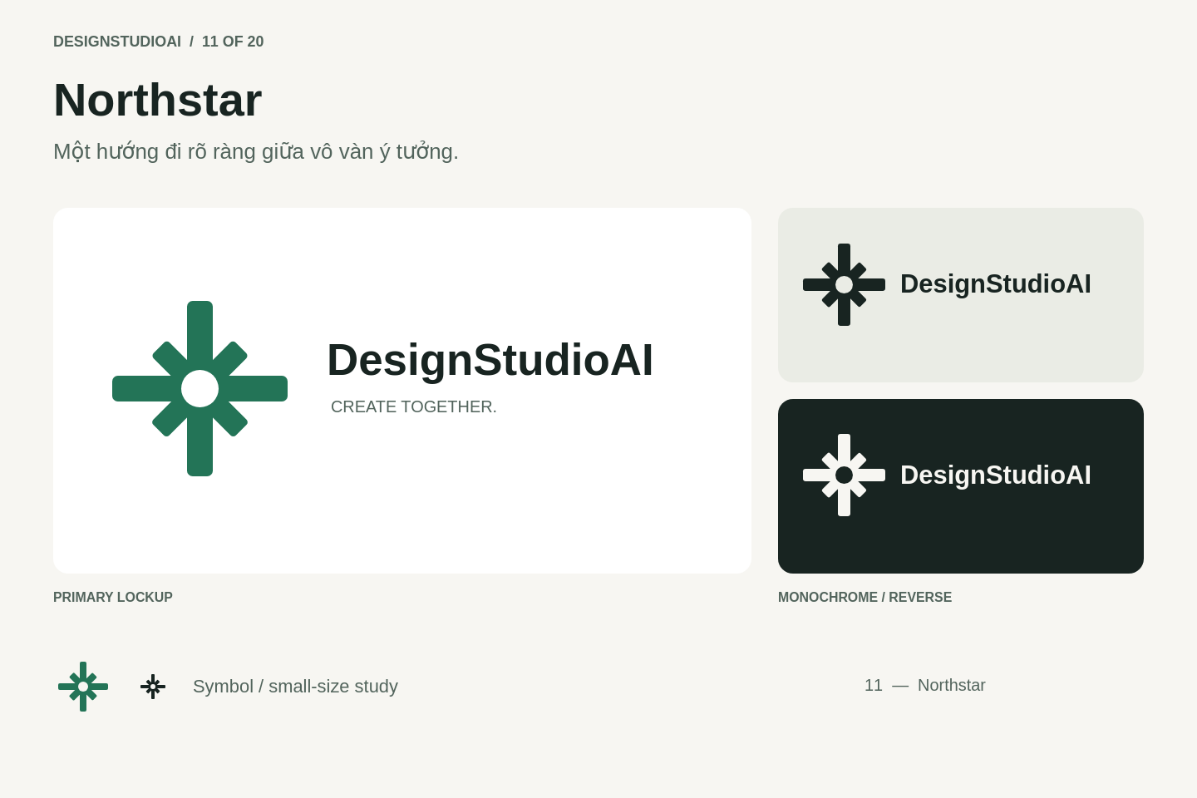
Notes:
Design Studio AI: 11 — Northstar. Structured components rendered as an image.

Slide 13
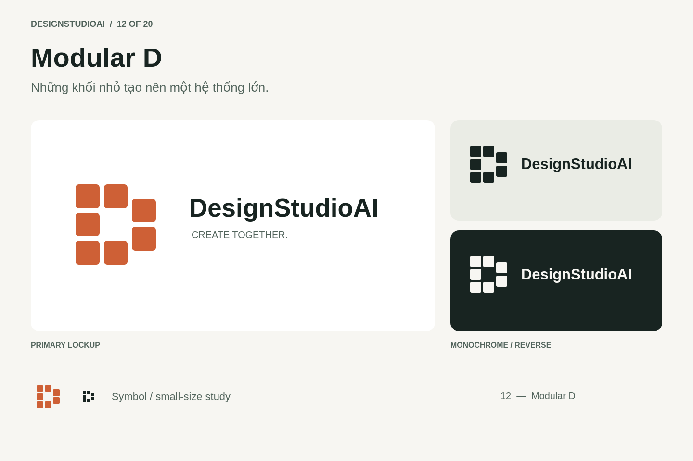
Notes:
Design Studio AI: 12 — Modular D. Structured components rendered as an image.

Slide 14
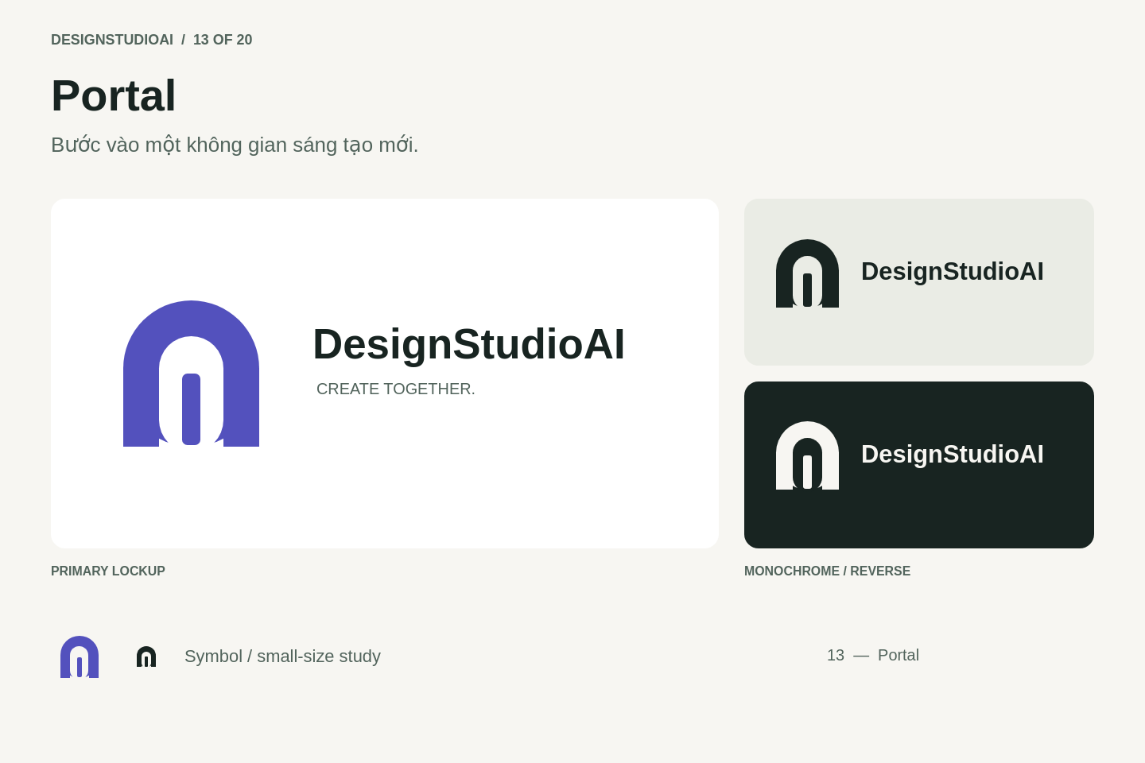
Notes:
Design Studio AI: 13 — Portal. Structured components rendered as an image.

Slide 15

Notes:
Design Studio AI: 14 — Co-create. Structured components rendered as an image.

Slide 16
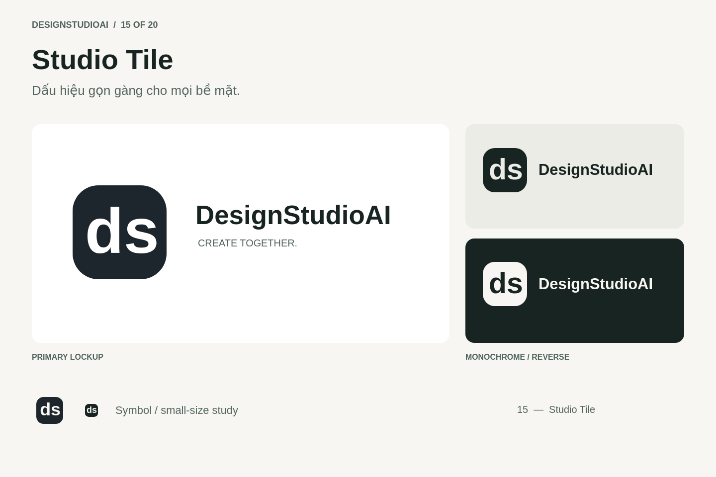
Notes:
Design Studio AI: 15 — Studio Tile. Structured components rendered as an image.

Slide 17

Notes:
Design Studio AI: 16 — Prism. Structured components rendered as an image.

Slide 18
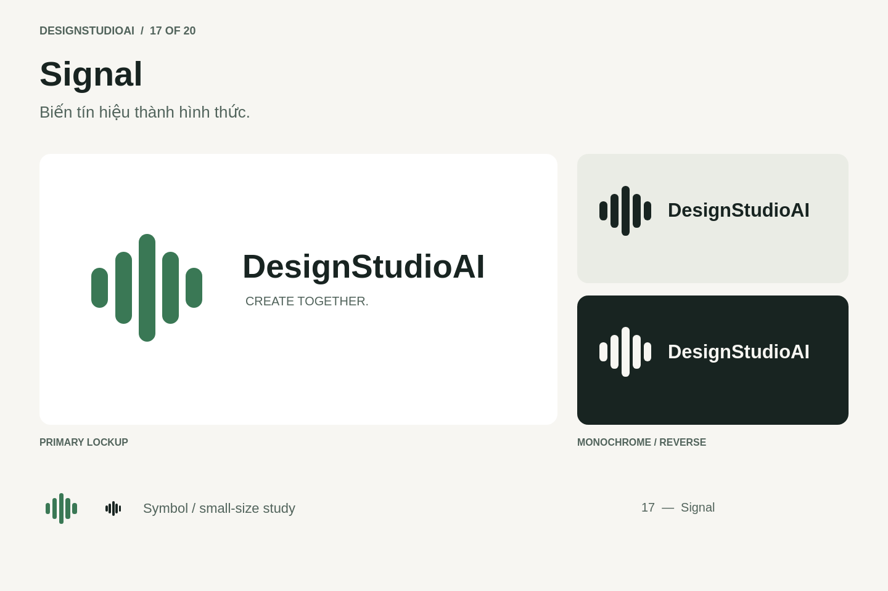
Notes:
Design Studio AI: 17 — Signal. Structured components rendered as an image.

Slide 19
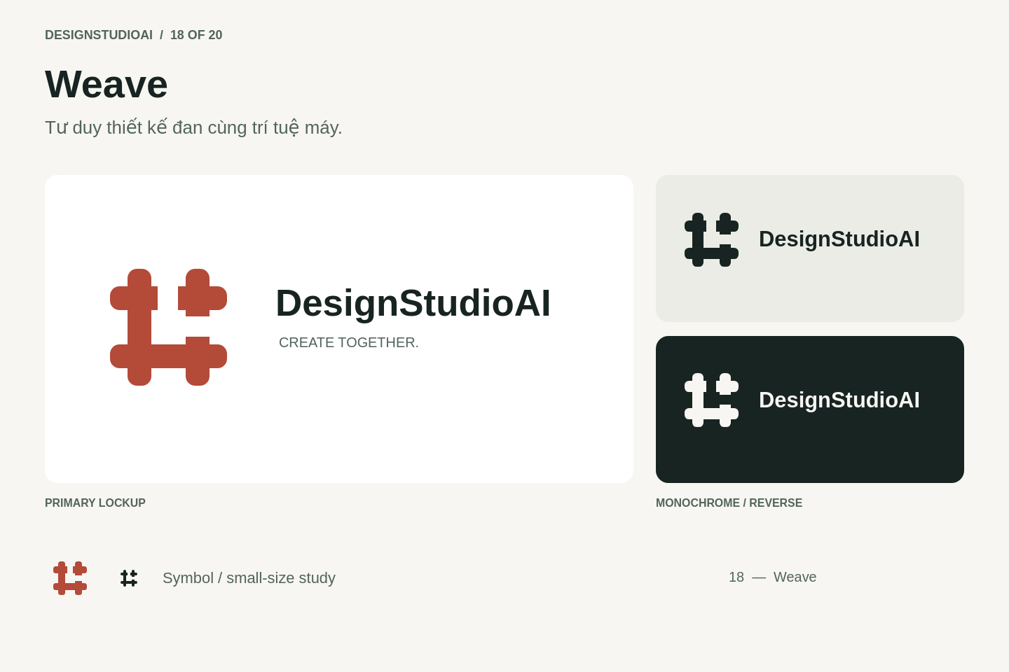
Notes:
Design Studio AI: 18 — Weave. Structured components rendered as an image.

Slide 20
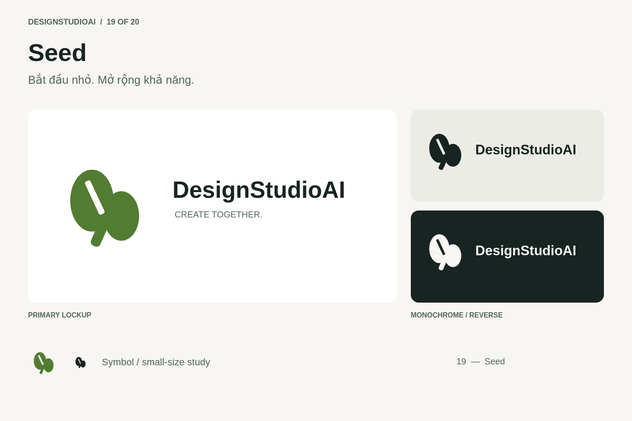
Notes:
Design Studio AI: 19 — Seed. Structured components rendered as an image.

Slide 21

Notes:
Design Studio AI: 20 — Forward. Structured components rendered as an image.

