Slide 1
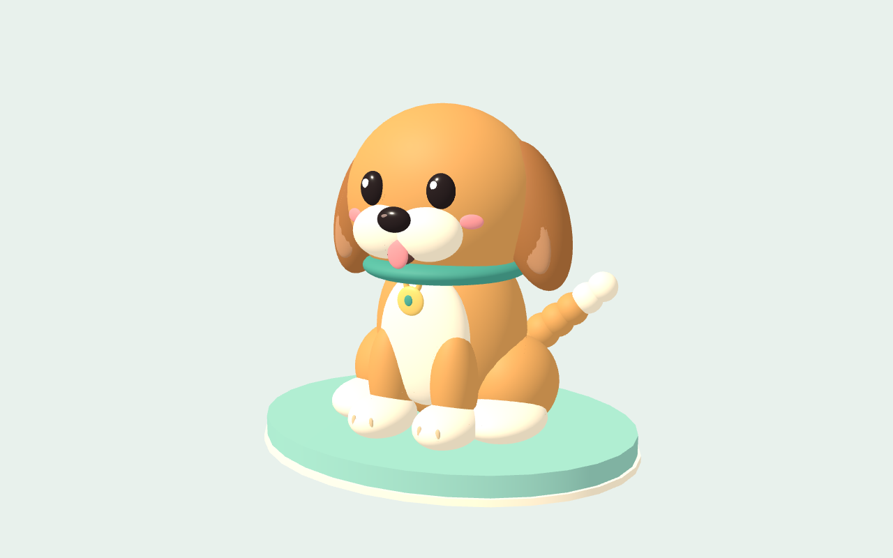
Notes:
Design Studio AI: Mochi — Puppy collectible. Structured components rendered as an image.

Slide 2
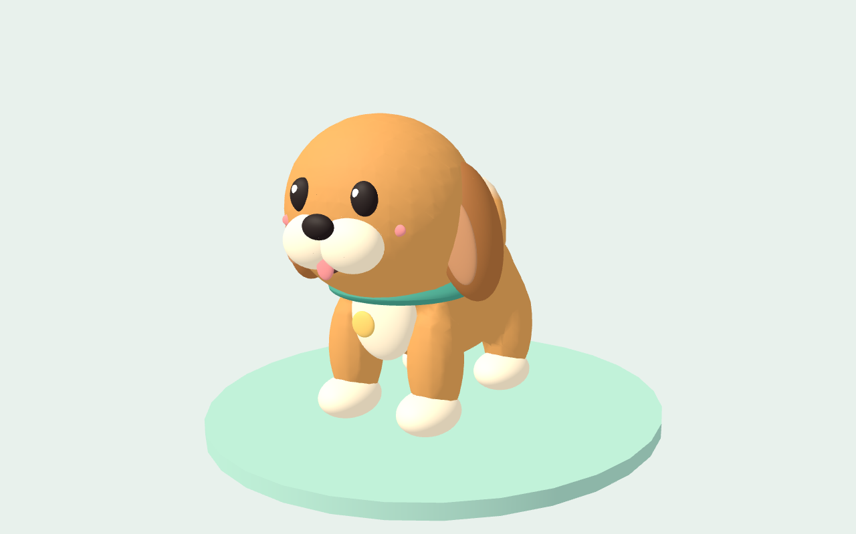
Notes:
Design Studio AI: Mochi — Rig & Motion. Structured components rendered as an image.

